Slide 1

పవర్ యాప్స్‌ను ఎలివేట్ చేయడం: రియాక్ట్‌తో PCF పోటెన్షియల్స్‌ను అన్లాక్ చేయడం
తెలుగు మైక్రోసాఫ్ట్ డైనమిక్స్ 365 మరియు పవర్ ప్లాట్‌ఫారమ్ కమ్యూనిటీ సమావేశం, జూన్, 2025

Slide 2

Pavan Mani Deep Y
Passionate Power Platform Consultant & Microsoft MVP
Blog: https://ecellorscrm.com
LinkedIn: https://www.linkedin.com/in/pavanmanideep/
Twitter: https://twitter.com/EcellorsCrm

Slide 3
Prerequisites for working on PCF
PAC CLI
VS Code
Windows Terminal
.Net Build Tools
Typescript
React, Fluent UI – for React Components -

Slide 4
Code Components….?
Unlike HTML, CSS, and Javascript, code components are rendered as part of the same context and loaded at the same time as any other components, providing a seamless experience for the user.
Bundle all the files into a single solution package file and move across environments

Slide 5
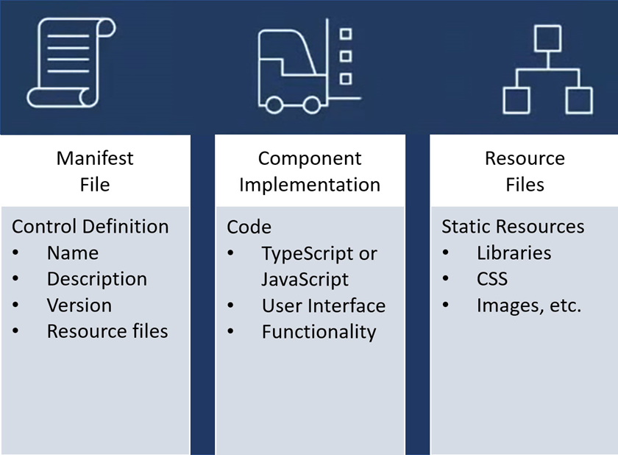
PCF Components

Slide 6
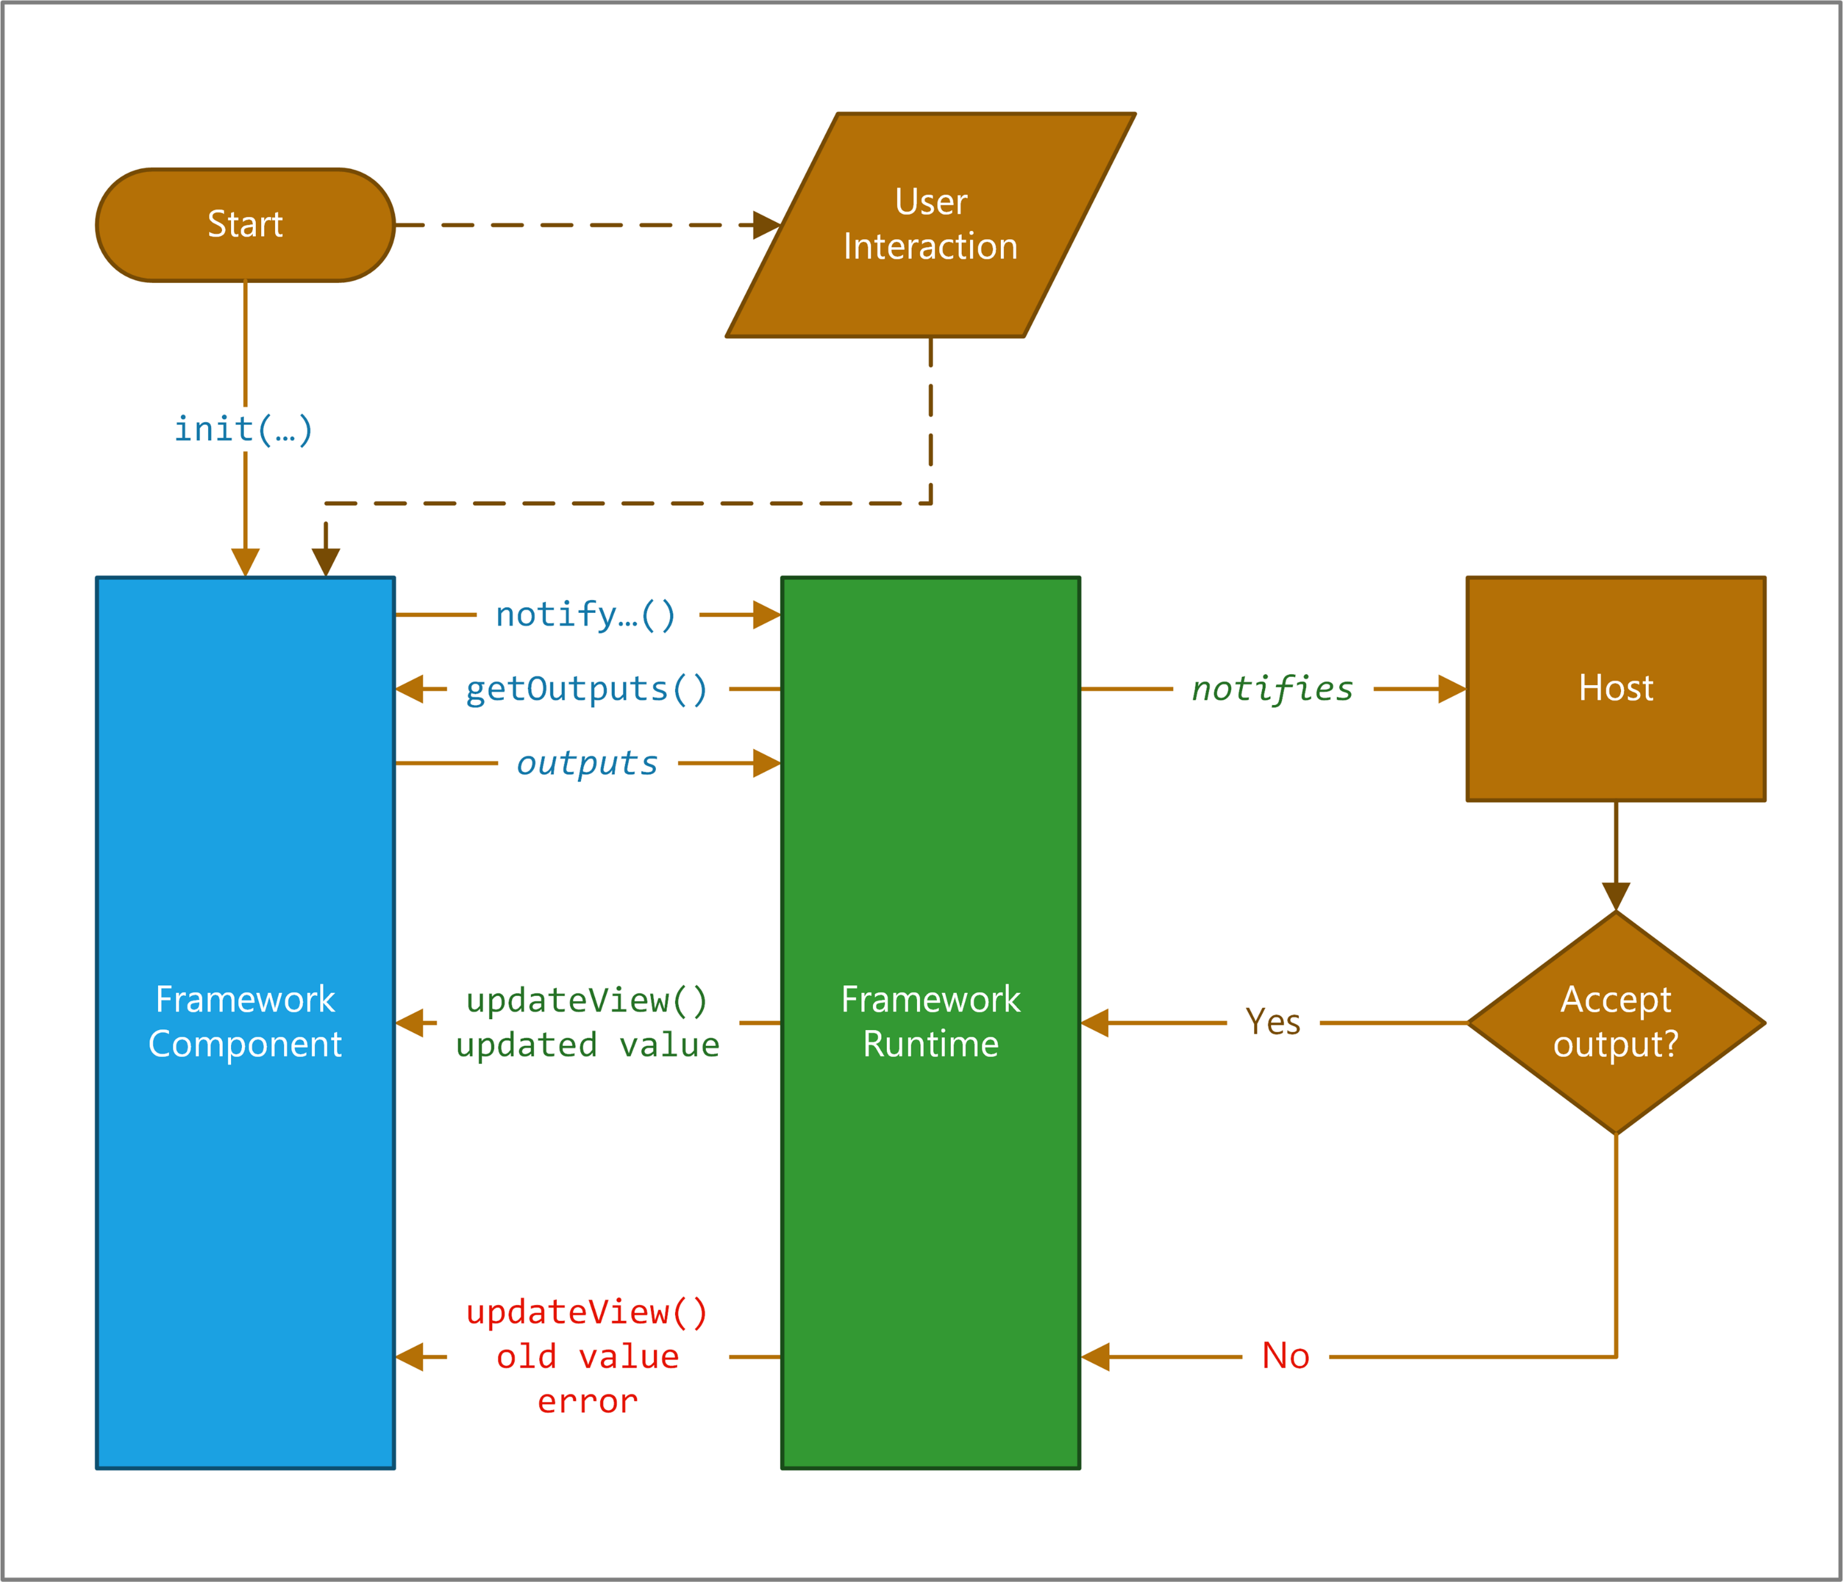
PCF Life Cycle

Slide 7
Life Cycle Methods of PCF
init: This method is called when the control is initialized. It is used to set up the control, including event handlers, and to render the initial UI.
updateView: This method is called whenever the control needs to be updated, for example, when the control's data or properties change. It is used to re-render the UI with the latest data.
getOutputs: This method returns the current value of the control's outputs, which can be used by other components or stored in the database.
destroy: This method is called when the control is removed from the DOM. It is used to clean up resources, such as event handlers, to prevent memory leaks.

Slide 8
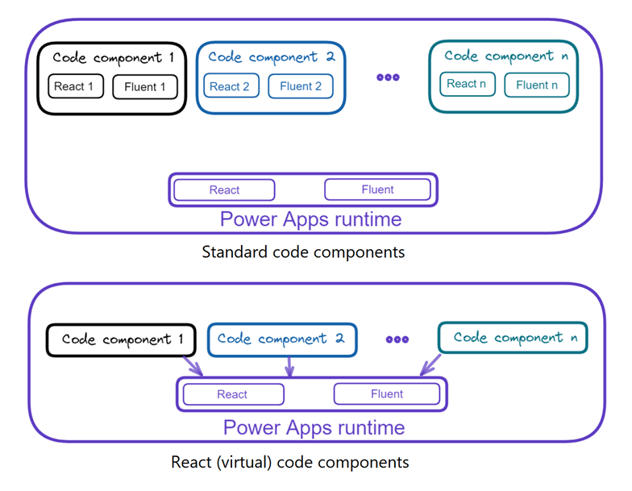

Slide 9
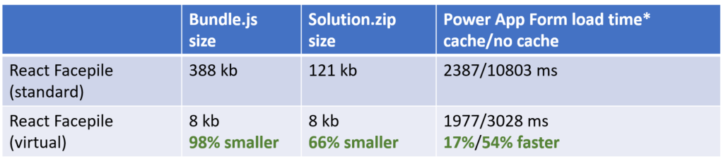
Standard vs React
Above are some high-level numbers comparing standard and virtual versions of FacePile control on development machine.
As you can see from the statistics above, in React-based code components, the React and Fluent libraries aren’t included in the package because they’re shared. Therefore, the size of bundle.js is smaller.

Slide 10
React PCF
1. Component-Based Architecture
Uses
modular development, making it easier to structure and reuse UI components.
Reduces repetitive code and improves maintainability.
2. Virtual DOM for Optimized Performance
React’s Virtual DOM efficiently updates only the changed parts of the UI instead of re-rendering the entire DOM.
This leads to faster UI updates and better responsiveness within Power Apps.
3. Code Reusability
Developers can reuse React components across different PCF controls.
Encourages consistent UI patterns across multiple PowerApps implementations.
4. Seamless Integration with Power Apps Libraries
Power Apps provides preloaded platform libraries for React and Fluent UI, eliminating the need to bundle them separately.
This results in smaller control sizes and quicker load times.
5. Rich UI and Accessibility via Fluent UI
Fluent UI offers enterprise-grade UI components that align with Microsoft’s design principles.
Improves user experience and ensures accessibility compliance.
6. Future-Proofing
React continues to evolve, ensuring long-term support.
Its active community and ecosystem make it a reliable choice for PCF controls.

Slide 11
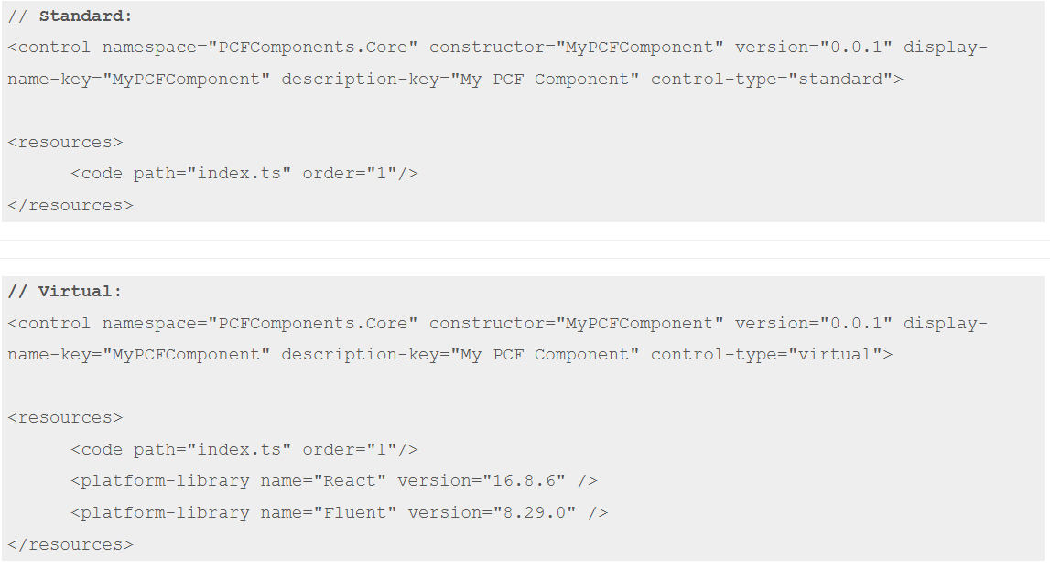

Slide 12

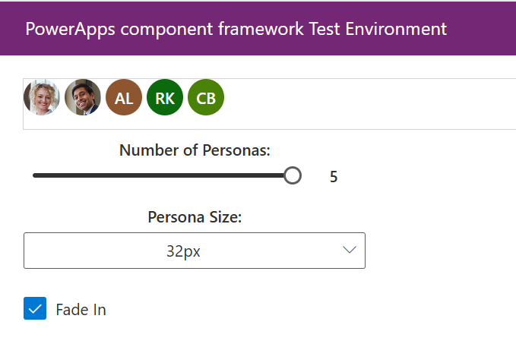
Goal: Build a Facepile component in PCF using React & Fluent UI.
Key Features:
Display user avatars.
Custom styling & interactions.
Use Case

Slide 13
Demo

Slide 14
Q & A

